Slide 1
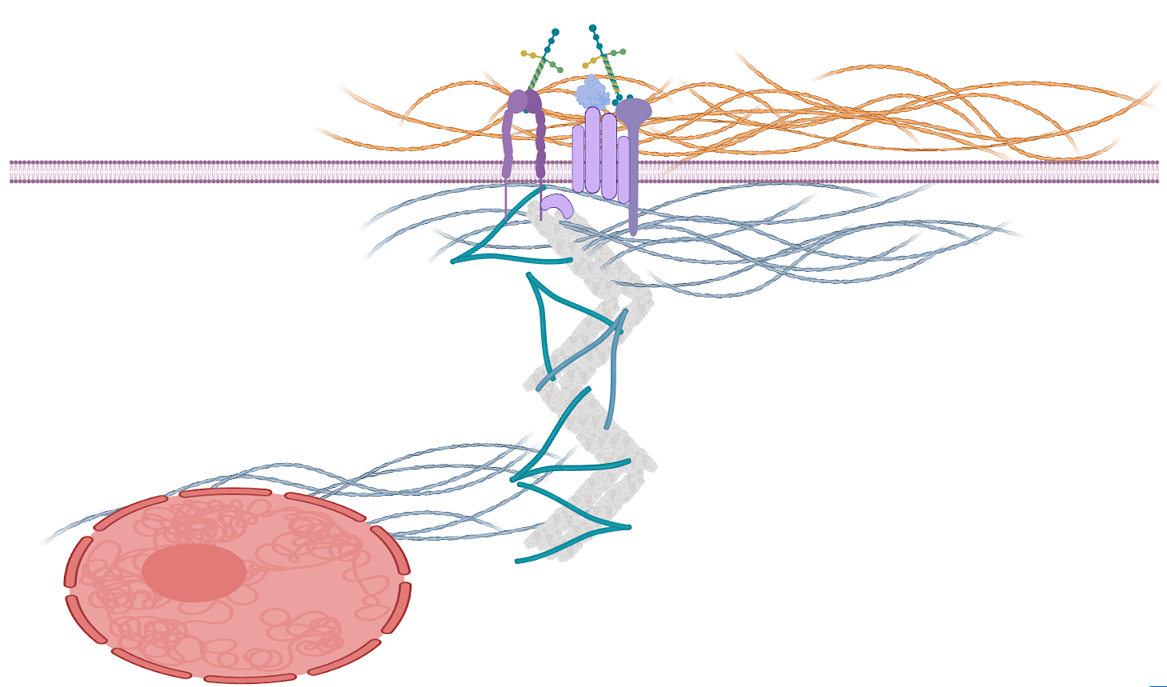
Filamin C has become a common link to cardiomyopathies
Filamin C (FLNC)
ECM
Ig domains
costamere
dimerization
domain
FLNC
actin-binding
domain
cytoskeleton
sarcomere
FLNC Variants in Patients with DCM
Z-disk
nucleus
Splice
~21%
FLNC has >12 known interaction partners in Z-disk & costamere (including BAG3)
Truncating
(nonsense or frameshift)
~20%
~59%
FLNC variants found in all major forms of cardiomyopathy
Missense
>100 variants reported in past 5 years
Verdonschot et al. (2020) Human Mutation

Slide 2
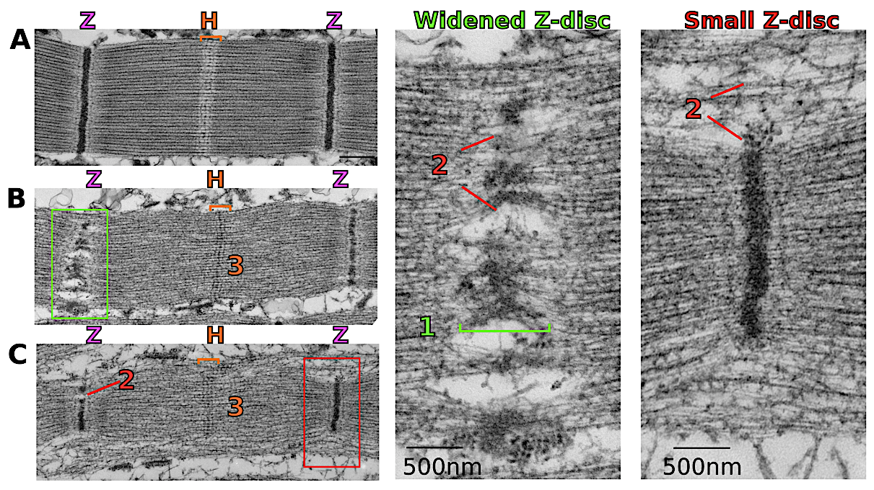
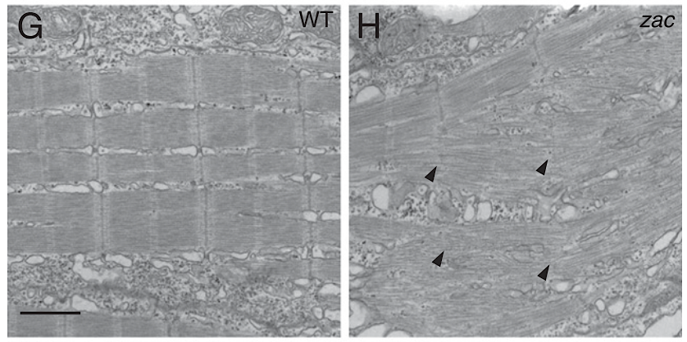
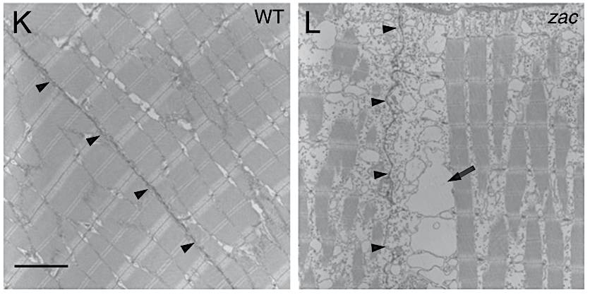
Animal models of Filamin knockdown show a breakdown of subcellular structure
Fish embryo skeletal muscle
Drosophila IFM
WT
Filamin-KD
WT
Filamin-KD
Fujita et al., (2012) Developmental Biology
González-Morales et al., (2017) PLOS Genetics

Slide 3
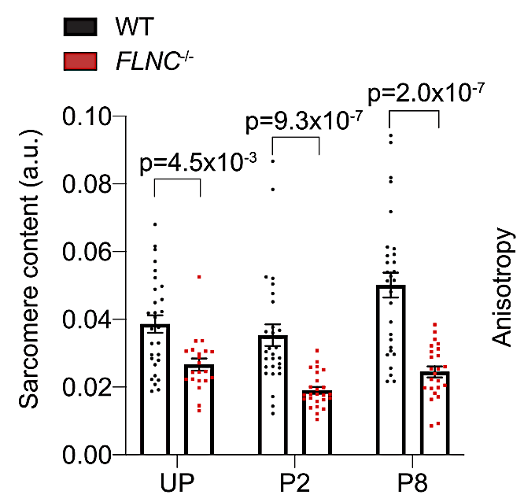
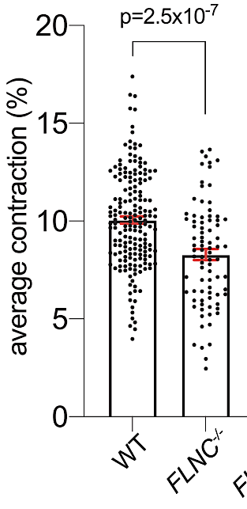
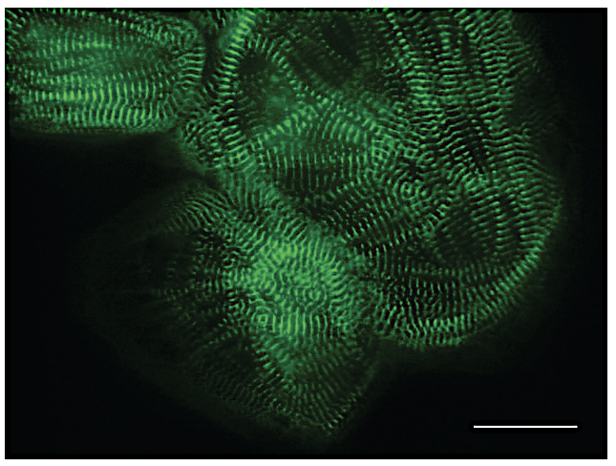
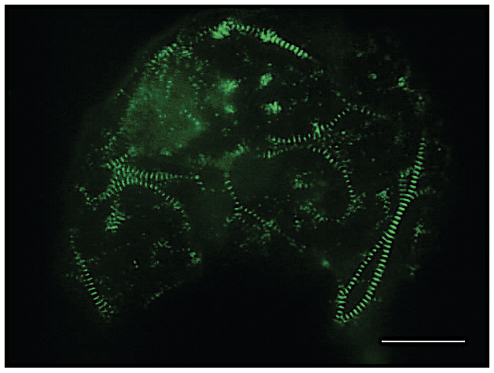
Human stem-cell derived cardiomyocytes without Filamin C exhibit reduced sarcomere content & contractility
Control
FLNC–/–
The role of Filamin C in regulating the structure & function of adult mammalian hearts & its involvement in DCM remains poorly understood.
Agarwal et al., (2021) Circulation Research

Slide 4
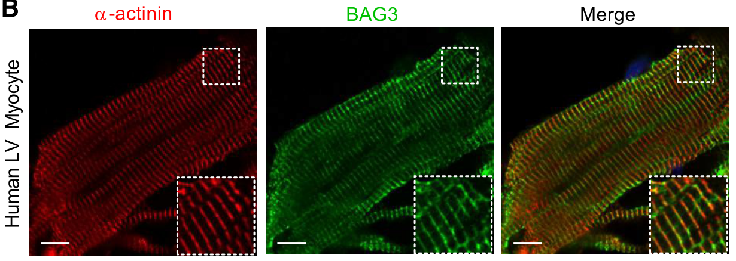
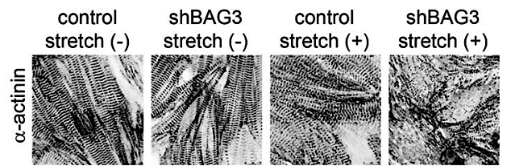
BAG3 helps maintain structural integrity of the Z-disk and regulates Filamin C production & degredation
𝛼-actinin
BAG3
Merge
Filamin C
transcription
BAG3
Human LV Myocyte
Misfolded Filamin C
degredation
Stress-induced myofibril damage
BAG3 and Filamin C may play similar roles in terms of structural stability of the Z-disk
Martin et al., (2021) Am. J. Physio.
Hishiya et al., (2010) Circ. Res.

Slide 5
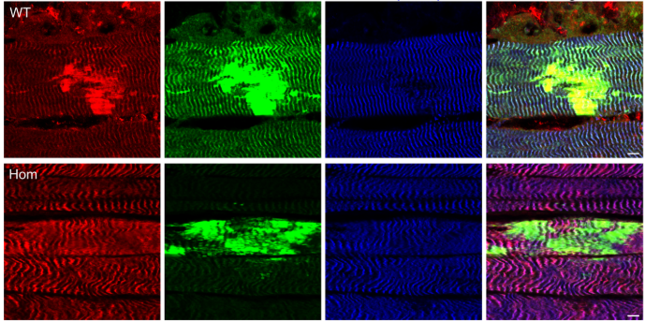
FLNC and BAG3 are recruited to sites of damage in skeletal muscle
Exercise-induced sarcomere lesions in mouse soleus
BAG3
FLNC
Titin (z-disk)
Merge
Control
FLNC mut
The interaction between FLNC and BAG3 may be critical for maintaining Z-disk structure in muscle during damage repair (or just all the time).
Schuld et al., (2020) Acta Neuropathologica Comm.

Slide 6
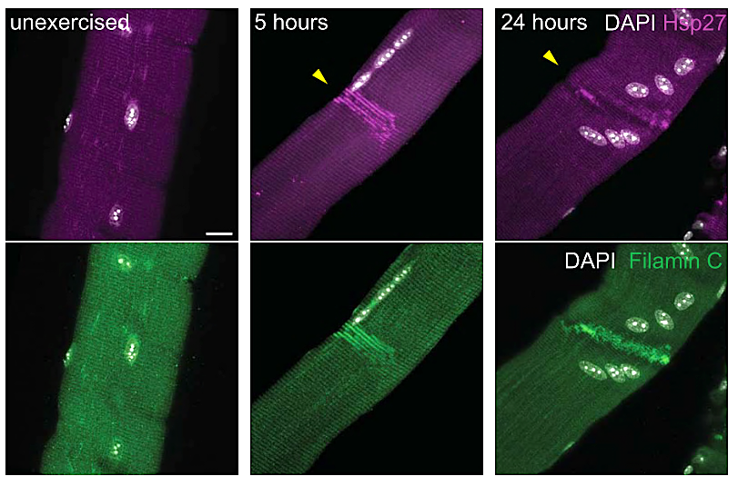
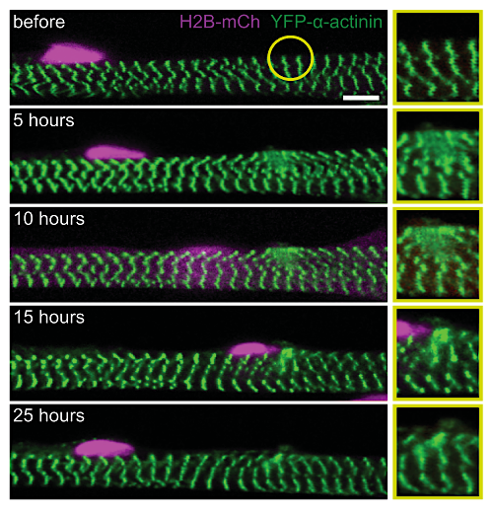
FLNC and BAG3 are recruited to sites of damage in skeletal muscle and may be involved in nuclear migration
Roman et al. (2021) Science

Slide 7
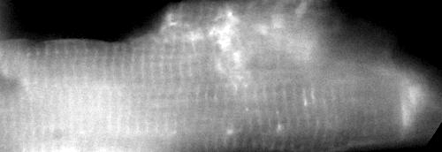
Main Question: What is the role of the BAG3-FLNC interaction in Z-disk maintenance in the heart?
Approach:
Employ laser nanoablation in live cardiomyocytes for targeted Z-disk destruction
Quantify time-dependence of fluorescence as a proxy for protein dynamics during repair
780 nm femtosecond Titanium-Sapphire Laser
Short-term Research Goals:
Ablate Z-disks without killing healthy cardiomyocytes
Quantify fluorescently tagged BAG3 dynamics during the repair process
cardiomyocyte
Single intact cardiomyocyte from an adult
BAG3-GFP^{+/+} mouse provided by Prof. Ju Chen

Slide 8

Pilot Study: Does BAG3 localize to sites of sarcomere damage in healthy cardiomyocytes?
Video of Intact Adult Mouse Cardiomyocyte
with BAG3-GFP^{+/+}
YES!! We can laser-ablate specific regions (single myofibrils and/or Z-disks) in living cardiomyocytes without cell death!
YES!! BAG3 appears to rapidly localizes to sites of sarcomere damage!
Can we quantify BAG3 localization kinetics?
Dr. Linda Shi - Biophotonics Technology Center at UCSD

Slide 9
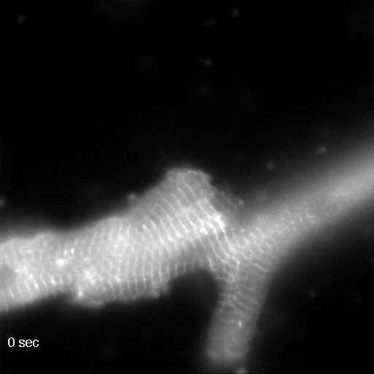
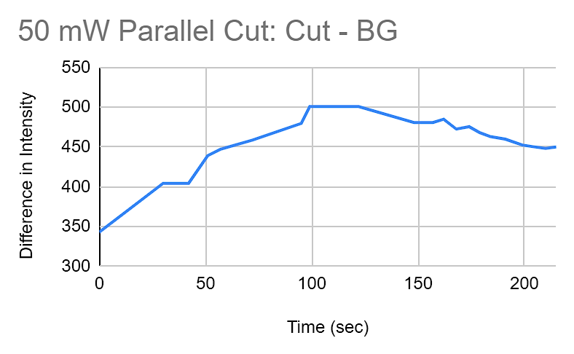
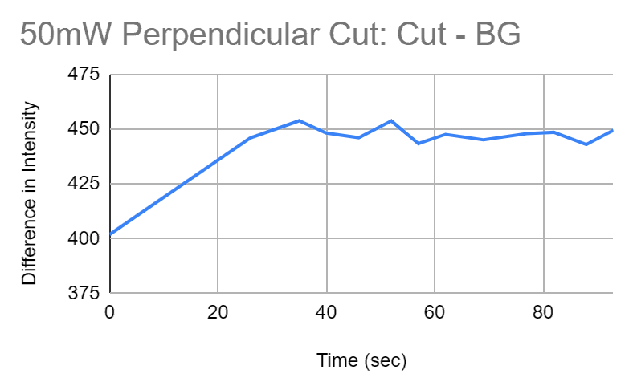
BAG3 localizes to sites of sarcomere damage in healthy, intact adult mouse cardiomyocytes
Video of Intact Adult Mouse Cardiomyocyte with BAG3-GFP^{+/+}
Parallel to Z-disks (50 mW)
Perpendicular to Z-disks (50 mW)
Dr. Linda Shi - Biophotonics Technology Center at UCSD
Timothy Guo, Suo (Sophia) Qin, Liuqing (Nina) Chen

Slide 10
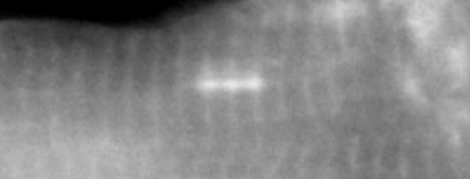
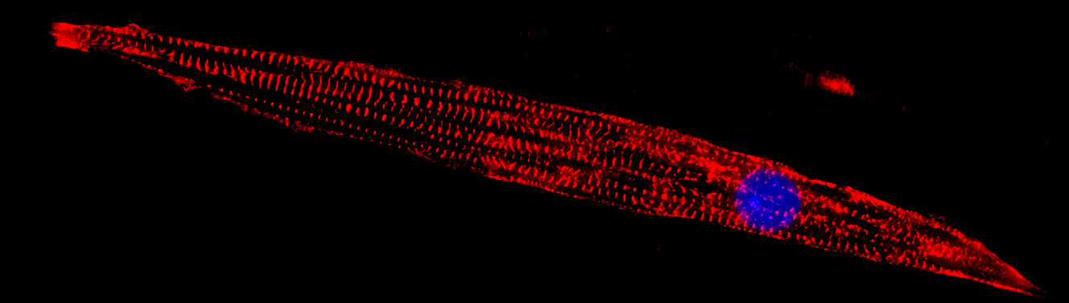
Next steps
Quantify damage-induced BAG3 localization kinetics in healthy adult mouse CMs
Capture nuclear migration? Is there a dependence of ablation proximity to nucleus?
Cross BAG3-GFP^{+/+}mice with FLNC-icKO mice?
Determine dependence of Filamin C in BAG3 recruitment to sites of sarcomere damage.
Switch to either neonatal mouse cardiomycoytes or human stem cell-derived cardiomyocytes (or both) to enable long-term time-lapse imaging
Roman et al. (2021) Science
Future directions (Joe at UW)
Does Filamin C also localize to sites of damage in cardiomyocytes?
Is there sarcomere injury-induced nuclear migration in cardiomyocytes?
Does sarcomere repair depend on Filamin C and/or BAG3 (and/or their interaction)?
Use fluorescently-tagged human stem cell-derived cardiomyocytes (Allen Institute, UW)
𝛼-actinin
DAPI
50 µm

Slide 14
EXTRA
SLIDES

Slide 15
For example, mutations in sarcomere genes such as desmin, αB-crystallin, myotilin, Z-band alternatively spliced PDZ motif containing protein (ZASP) and filamin C result in phenotypes that are very similar to that seen in cells in which BAG3 has been knocked down. Thus, the co-chaperone BAG3 and the chaperone Hsc70 play a critical role in maintaining the structural integrity of the sarcomere especially during mechanical stress
BAG3 helps rid the myocyte of misfolded and degraded proteins but also maintains the homeostatic balance between filamin breakdown and filamin production
The finding—that mutations in BAG3 were associated with the development of disrupted Z-disk structure, myofibrillar degeneration and disorganization—led Hishiya and colleagues to assess the effects of BAG3 in neonatal rat myocytes

Slide 16
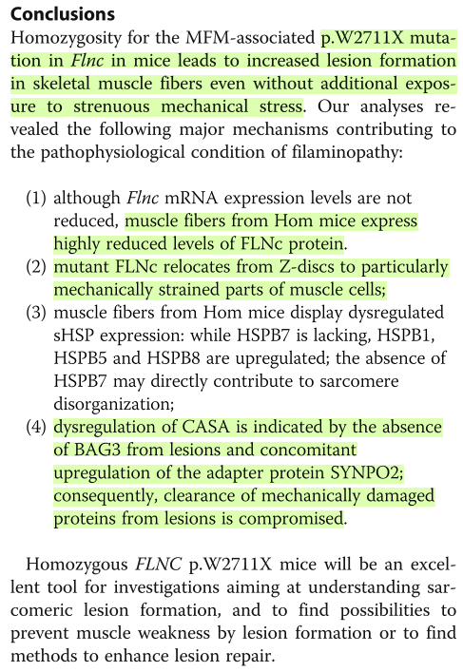
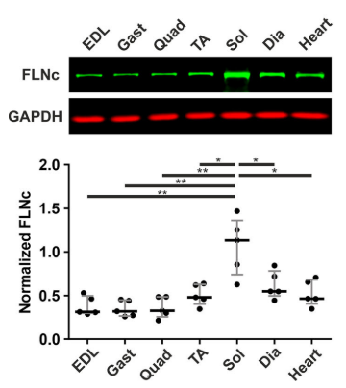
The interaction between FLNC and BAG3 may be required for sarcomere damage repair
Exercise-induced sarcomere lesions in mouse soleus
BAG3
FLNC
Titin (z-disk)
Merge
Hom = homozygous mice for FLNC mutation W2711X
Control
Mouse WT Filamin C Expression
FLNC mut
Homozygous expression of the myofibrillar myopathy-associated p.W2710X filamin C variant reveals major pathomechanisms of sarcomeric lesion formation – Schuld et al., 2020 Acta Neuropathologica Comm. (Fürst Group)

Slide 17
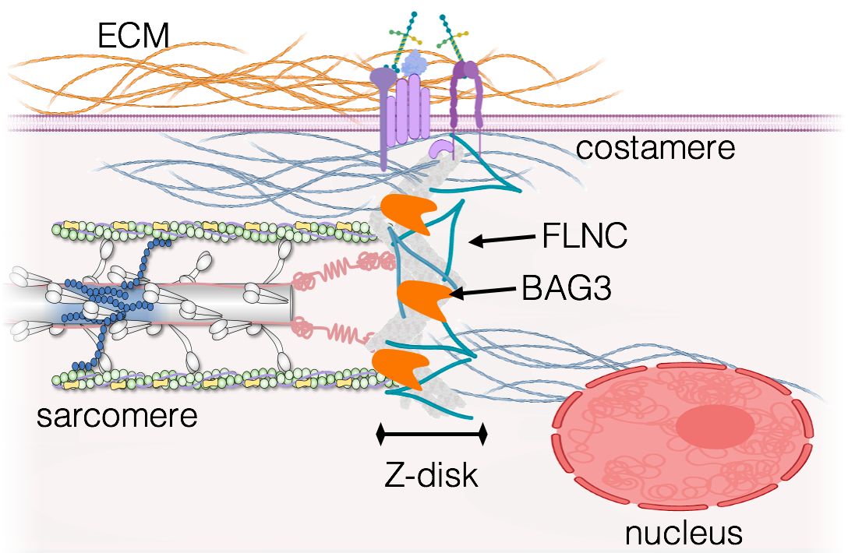
What is the role of the BAG3-FLNC interaction in Z-disk maintenance in the heart?
Big-picture research questions:
Can cardiac Z-disks repair themselves without Filamin C (or BAG3)?
Does BAG3 and/or Filamin C localize to damaged Z-disks in the heart?
Does BAG3 localization depend on its interaction with Filamin C (and vice-versa)?
Does the nucleus migrate to sites of damage in cardiomyocytes? (and what about if FLNC is gone?)

